Slide 1
Trivial i2a
David Fernández Álvarez UO229973
Elías García Martínez UO167077
María del Rosario González Tuero UO232036
Cristóbal Herrero Iglesias UO230501
Jesús Martínez Rebordinos UO232718
Adán Suárez Cuesta UO230540

Slide 2
Introduction to the game
The aim of the game is to throw a dice, obtain a number, move the piece to the correct square, answer a question and move on, as many times as the user may want.
Besides, we have to correctly answer one question of each type, and the player who does it first, will be the final winner!

Slide 3
First deliverable
The first deliverable was a parser.
We obtain the questions in GIFT format and then convert all to Json (storing them in MongoDB) and also to XML.
The file was processed using parser combinator in Scala format.
The architecture used was Pipe and Filter.

Slide 4
Second deliverable
The second deliverable was a desktop application.
We used JSonSimple to process the questions.
You could choose the number of players and the size of the board, both of them being generated dynamically.
We used Java and Swing library for the interface.

Slide 5
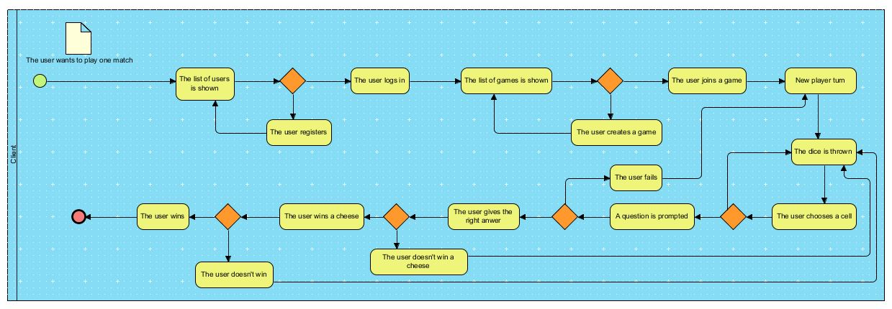
Third and final deliverable
Thanks to Visual Paradigm we can explain, through a BPM diagram, an example of a game instance, as shown below:

Slide 6
Final deliverable
Thanks to good architecture decisions of the second deliverable (MVC), which was well structured, we had little to do, it was just a matter of integration, that was solved by means of the Play Framework and developing some pages in HTML.

Slide 7
Task distribution
We distributed the tasks in the following way
GUI
Logic of the game
Logic of the questions
Integration by Play
Documentation
Web page

Slide 8
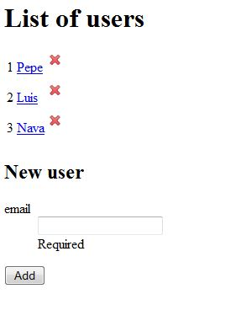
How it works: Choosing a user
The first thing you have to do before playing will be choosing a user. If you don't have any, write your name in the field and click on the Accept button. A list with all the users will appear, in which you can select your user. Now you can go to the next step.

Slide 9
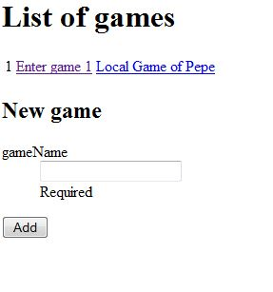
How it works: Choosing a game
You have to choose among the available games and pick the one you want to join to.
If there's not available games, you can create a new one in the same way as a player is created. Just enter the name of the game, that will be added to the list of games when you click on accept.

Slide 10
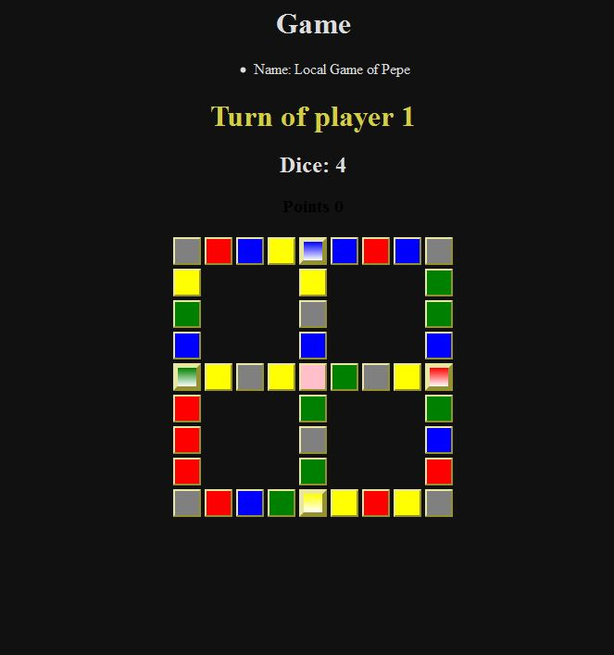
How it works: Play!
After selecting a game, you will see a window with its current state. In that page it appears the name of the game, the current player and the value of the dice.
In addition, you can see the board state, showing to which cells the player can move.

Slide 11
How it works: Play!
The way to play is very simple: the dice is thrown automatically, so you don't have to care about that.
Once the value of the dice is obtained, the cells that allow a possible movement have a thick border painted in a golden color.
Clicking in one of them will move you to this cell, and a question will be asked to you.
Depending on the color, the question could be about History, Entertainment, Science or Geography.

Slide 12
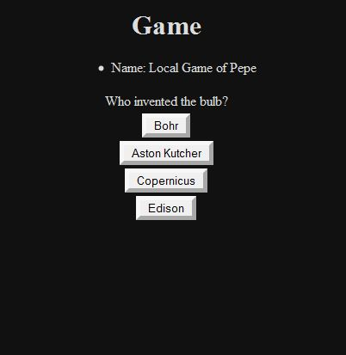
How it works: Play!
You will have to answer the question correctly to keep playing. If you fail, you will give the turn to the next player. But, watch out!
If you are in a cell that has a gradient color, it means you are in a 'quesito' cell! Answering correctly to the proposed question will give you a wedge. Once you get four, you win the game!

Slide 13
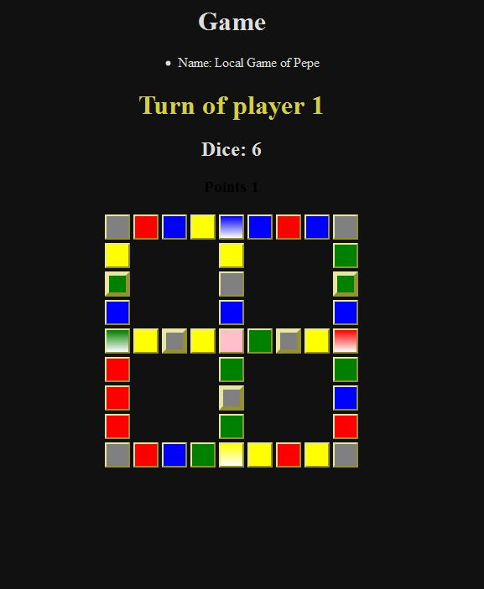
How it works: Play!
There‘re some special cells: the one in the center, which will randomly ask you a question of any category and the grey ones will allow you to continue without answering a question, a pretty good advantage.

Slide 14
Current functionalities
You can register as a user and create new games and join them at any time.
The result will be saved after you leave, allowing you to give up a match, join another and come back to the first one.
The functionalities of the game are fully operative, developed to be adapted to any necessities such as a different boards or number of players.
If you are clever, you can win!

Slide 15
Possible extensions
Our team was compossed by six people, with the same work weight as others with more members, so we didn’t have enough time to extend the application as far as we had wished.
The possibles extensions could be:
Save games in a JPA database.
Using REST services to play games from different computers. (We use REST, but only locally)
Adding user options for size and number of players.

Slide 16
Thank you
Any question?

